Slide 1
Family Hub
Networks Overview

Slide 2
What are Family Hubs?
A Family Hub is a system-wide model of providing high quality, whole-family, joined up family support services through partnership working.

Slide 3
Who are Family Hubs For?
All families 0-19 (25 SEND)
They are for families who need:
a helping hand
intensive help from targeted services
extra help from more than one service
help to navigate the system
Our core focus will still be 0 - 4yrs ages
From pregnancy
Through the child’s early years and later
Into early adulthood until they reach the age of 19
Or up to 25 for young people with special educational needs
and disabilities

Slide 4
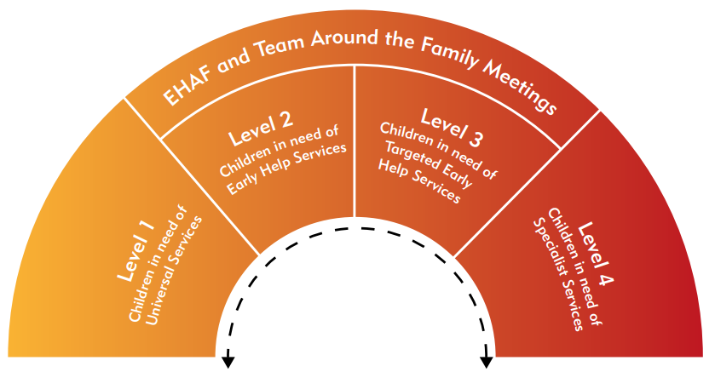
Who are Family Hubs For?
Children and families in need of early help or targeted services (Tiers 2 and 3)
All children and Families

Slide 5
Is this a focus only on buildings?
Hubs are not necessarily about creating new buildings but focus on bringing services together and changing the way help and support is delivered locally to families.
In practice, this will be a mix of using children’s centres and other LA spaces, and repurposing other public buildings such as libraries etc.
A significant proportion of Family Hub services will be delivered virtually through programmes, websites, online resources, texting services etc.
Other services will be delivered in the homes of families themselves – outreach will form an integral part of Family Hubs, overcoming the access barriers many families experience in receiving the support they need.

Slide 6
Family Hubs Core Offer.
Information, Advice and Guidance
Signposting and referrals to relevant services
1 main physical hub site with several spokes eg library (this may differ in rural areas)
Universal antenatal and postnatal health services
Targeted parenting programmes and family support for families with C&YP aged 0-19 (25 SEND)
Community Voices through:
Parent/carer panels, Young People Panels,
Virtual consultation groups
SEND services
Youth Services & activities
Volunteering opportunities
Public Health interventions e.g. breastfeeding, safer sleeping, healthy lifestyles, relationships and sex education, C-Card, smoking cessation etc
Each FH Network will include additional services and interventions based on local need and the services available within that locality.
Universal and targeted support for new parents and for parents with preschool children

Slide 7
What services and interventions could be included in the Family Hub Network offer in Rushcliffe?
Antenatal and postnatal care – maternity clinics and appointments
Support groups for new parents
Health assessments
Breastfeeding support
Sleep programmes
Healthy Family Team appointments and clinics
Self weigh
Speech and language interventions
Help to access Childcare
Family support
School readiness interventions
Public health interventions
Youth training and employment
Volunteering opportunities
Parenting programmes
Money management
Supporting parents into employment
Contraception and Sexual Health Services
Counselling / emotional health support
Violence and domestic abuse advice and support
Reducing Parental Conflict interventions
SEND services up to 25 years
Stay and play sessions
Relationships and sexual health advice
Substance use advice, appointments and groups
Youth Services and activities
C-Card Scheme
Housing advice and support
Signposting and referral to specialist service
FOOD Clubs/food insecurity
Links to sports and leisure activities
Social prescribing
Peer support
Stop Smoking and healthy lifestyles
Welfare Rights
Notes:
Are you interested

Slide 8
Current Children’s Centre Core Offer (0-4yrs)
A. Early identification and prevention of risk of harm
Time limited 1:1 Family Support
Family Support Appointment sessions
Parenting Programmes inc. Incredible Years, 1,2,3 Magic, Sleep Tight, Solihull, EPEC Being a Parent, Freedom Programme,
Baby Massage
Theraplay
B. School Readiness
Forest Schools
Little Learner Creche
Little Talkers
Let’s Play
Now I am Two
Toileting Workshops
PEEPS
Nottinghamshire Children’s Centres will contribute to the following outcomes:
D. Improved Health and Wellbeing of Children and Parents
BABES Breastfeeding Groups
Antenatal BABES
Weaning Workshops
Parent’s Health & Emotional Wellbeing Group (PHEW)
Opening Doors With Confidence
New Parents Group
Family Food & Fun
C. Work Readiness
Volunteering Training:
Early Years, Breastfeeding Peer Support, PHEW and EPEC
Opening Doors to Employment
Hosting adult learning
1-1 Information, Advice and Guidance
childrenscentreserviceinterventionguide.pdf (nottinghamshire.gov.uk)

Slide 9
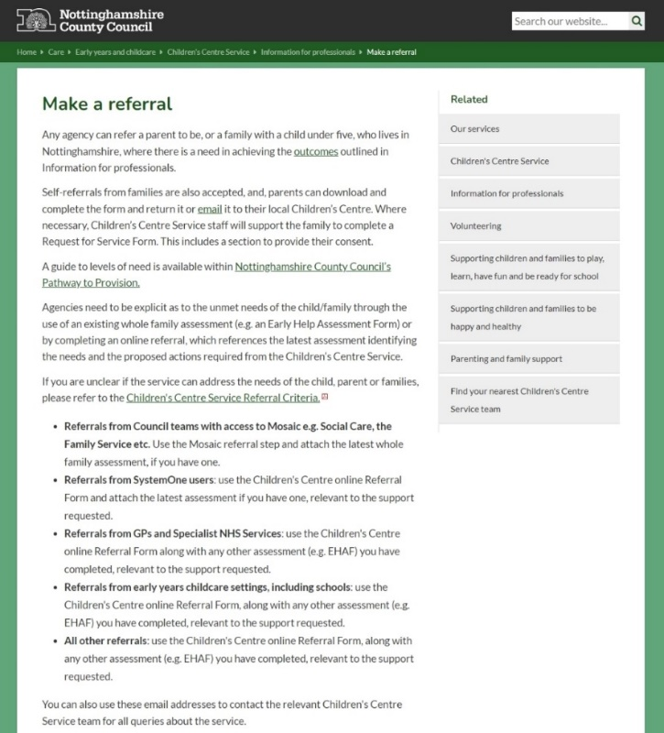
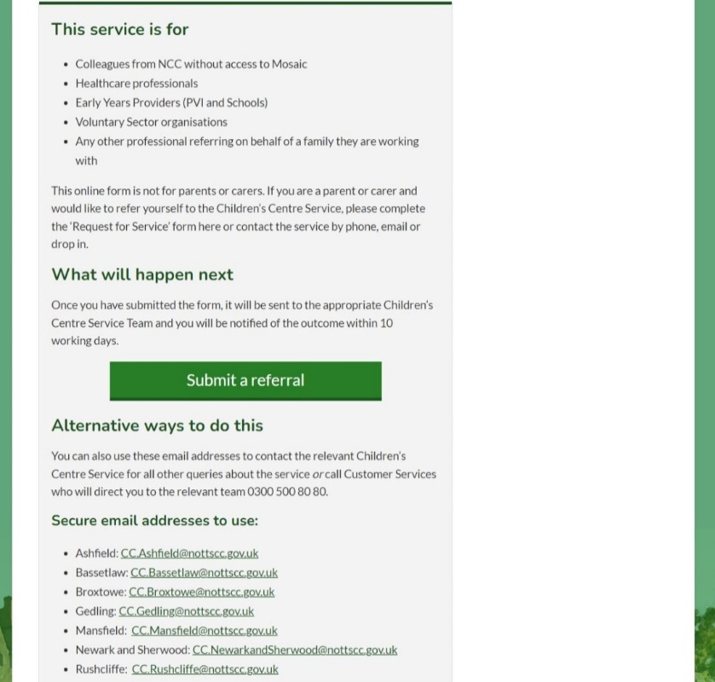
Family Hub / CC Professional Referral Form
One form for all (0-19) to be launched in 2025.
You can currently still refer into the children’s centre via our professional referral form online: Make a referral | Nottinghamshire County Council

Slide 10
Current Children’s Centre Family Request for Service Process
All parents-to-be, parents and carers of children under 5 years who live in Rushcliffe can self-refer by completing a Request for Service Form:
ccsrequestforserviceform.docx (live.com)
Request for Service can be made :
Face to face with a member of children's centre staff
By telephone
By completing a Request for Service Form and either hand in or post to the relevant centre or by email to the District's secure email address
A new one form for all (0-19) to be launched in 2025 as part of the Family Hubs Network.

Slide 11
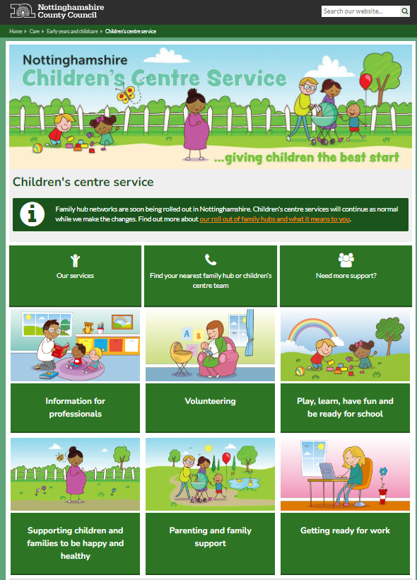
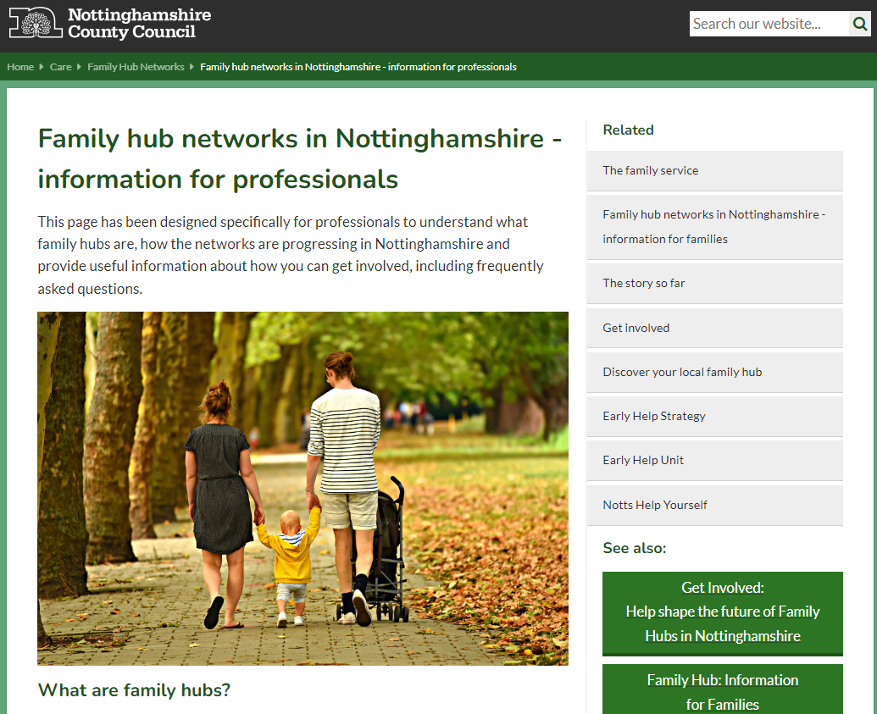
Further Children’s Centre Information: Children's Centre Service | Nottinghamshire County Council
Further Family Hub Information: https://www.nottinghamshire.gov.uk/care/family-hub/professionals

Slide 12
Where do you see your service within Family Hubs?
Your opportunities to develop and strengthen partnership working within Family Hubs.
Eg:
Navigator (sign posting) role, supporting families to the right service. We have an electronic directory of services document to assist you if required.
Room to deliver partner services or 1-1 work with families.
Providing your parent’s voice.

Slide 13
Next Steps?
Contact us if:
You have any other suggestions on how we can network together.
You would like us to attend your individual school staff meeting.
You have any further questions.
Invite to the Family Hub Launches:…………………………………..

Slide 15
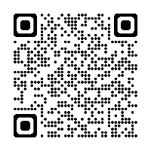
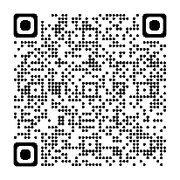
Or Search: ‘Children’s Centre Service Rushcliffe’
(to follow us or like our page)
FHRushcliffe@nottscc.gov.uk to join our mailing list or ask
us a question
0115 977 3749
(to speak to a member of our team)
Go to:
nottinghamshire.gov.uk/
childrenscentreservice
Drop in to one of our sites:
Bingham Children’s Centre,
Eaton Place, Bingham, NG13 8BE
Abbey & Lady Bay Children’s Centre,
Tewkesbury Close, West Bridgford, NG2 5ND

